Slide 1

The implications of picking A FSM over microstore
Electrical Engineering, EEMCS
Joost Buursink Fabian Widlund Emil Imhagen
Guus branderhorst
Stach Redeker Group 7

Slide 2
Our presentation is a little bit different

Slide 3
FSM? Microstore?
Let’s summarize quickly

Slide 4
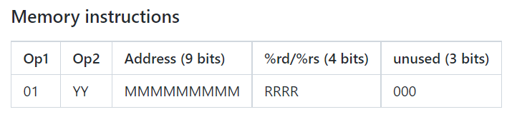
Finite state machine (fsm)
Let’s summarize quickly

Slide 5
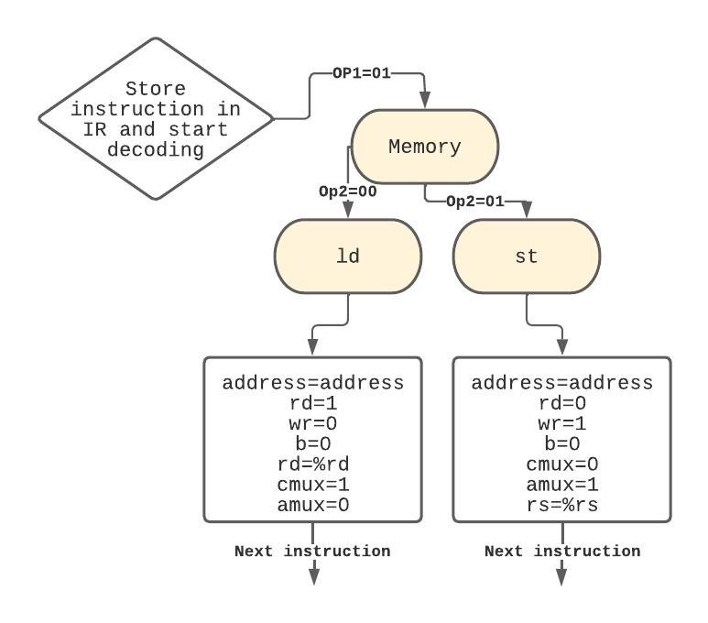
Finite state machine (fsm)
Let’s summarize quickly

Slide 6
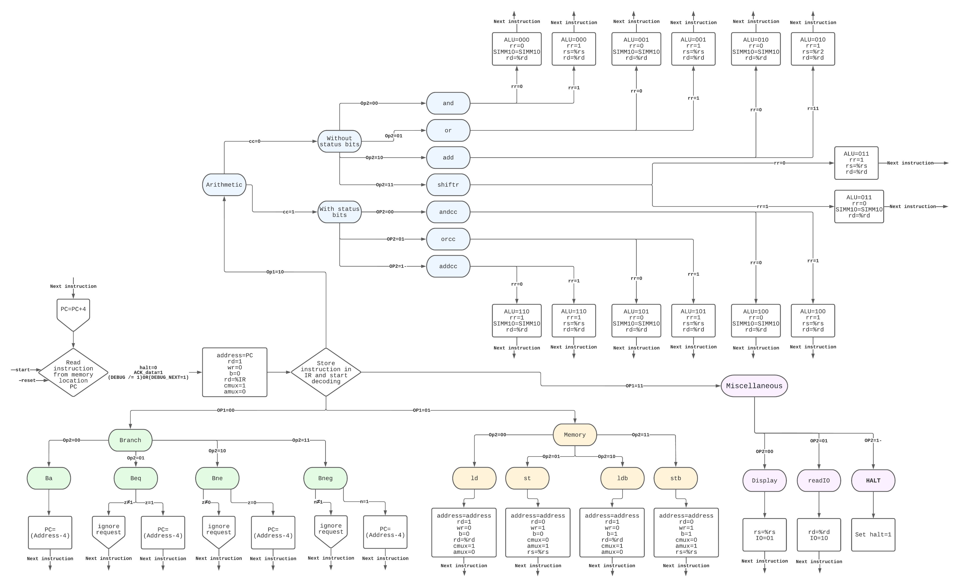
Finite state machine (fsm)

Slide 7
Finite state machine (fsm)
PC is incremented

Slide 8
Microstore
Let’s summarize quickly

Slide 9
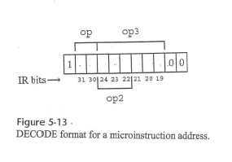
Microstore
Let’s summarize quickly

Slide 10
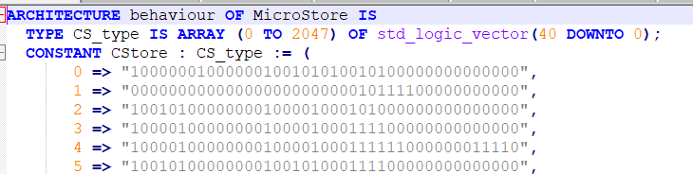
Microstore
Let’s summarize quickly

Slide 11
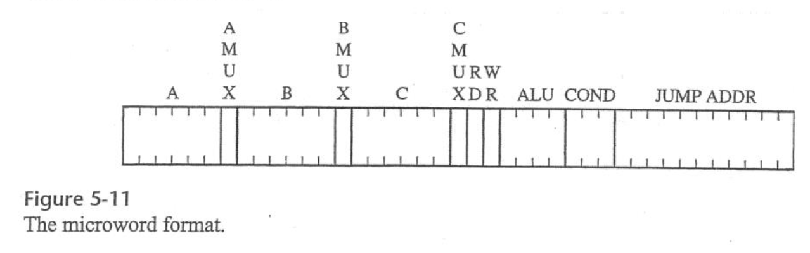
Microstore
Let’s summarize quickly

Slide 12
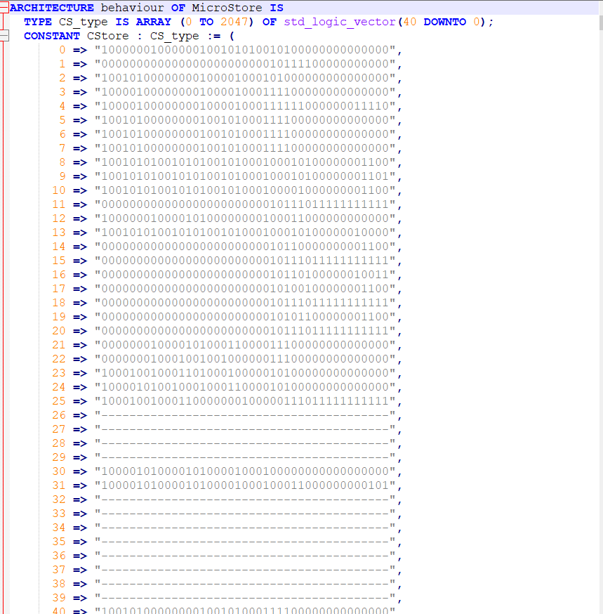


Microstore

Slide 13
Microstore
Increase PC and jump back to 0

Slide 14
Our hypothesis
FSM Microstore
Quite elegant for small instruction sets
Human readable
Can get quite large
Scales better for larger instruction sets
Not human readable
Requires a large LUT small instruction sets

Slide 15
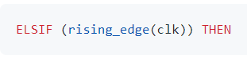
The implications of using a FSM

Slide 16
The implications of using a FSM

Slide 17
The implications of using a FSM

Slide 18
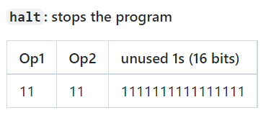
How do WE halt?

Slide 19
How do WE halt?
Just stopping the program counter doesn’t work

Slide 20
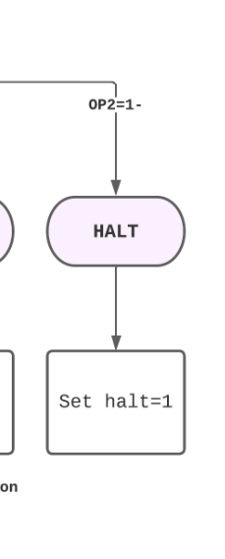
How do WE halt?
Most efficient solution? Stop the controller!

Slide 21
How do WE halt?
Most efficient solution? Stop the controller!

Slide 22
Halting in microstore?

Slide 23
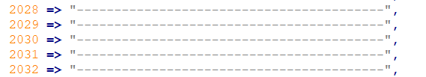
Halting in microstore?
Jump to an empty location. Problem solved.

Slide 24
The implications of using a FSM

Slide 25
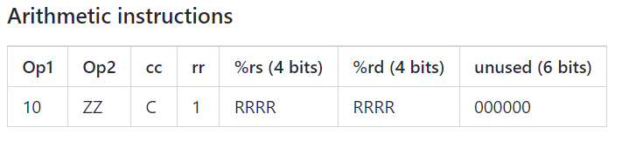
How do we know that the datapath is ready?
The datapath/ALU/memory may need more than one clock cycle to get an instruction done

Slide 26
How do we know that the datapath is ready?
The datapath/ALU/memory may need more than one clock cycle to get an instruction done
If the controller keeps pushing instructions -> problem!

Slide 27
First solution: can we get every operation done in one cycle?

Slide 28
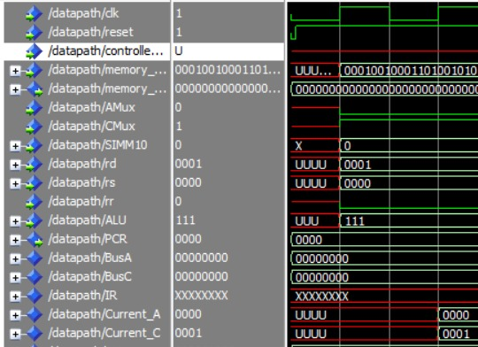
First solution: can we get every operation done in one cycle?
Metastability

Slide 29
First solution: can we get every operation done in one cycle?
Metastability

Slide 30
SECOND solution: can the contents of the fsm change?
No, because loops (counters) in a FSM are unwanted
And it would mess with our PC

Slide 31
So, we need to able able to cope with multiple clock cycles
How?

Slide 32
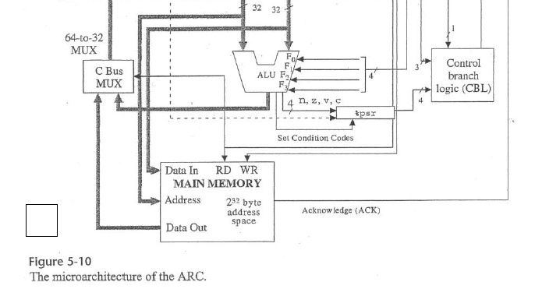
So, we need to able able to cope with multiple clock cycles
How?

Slide 33
So, we need to able able to cope with multiple clock cycles
What does ARC?

Slide 34
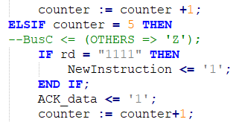
Acknowledge!

Slide 35
Acknowledge!

Slide 36
How does microstore know that the datapath is ready?

Slide 37
How does microstore know that the datapath is ready?
It’s natively baked in.

Slide 38
DEBUG MODE
Requirements
Load the contents of a memory address and display it using the seven-segment displays

Slide 39
Debug mode
2 new signals added to the controller allowing the DEBUG to step through the code 1 line at a time.
”DEBUG” is 1 if the debug switch is turned on.
”DEBUG_NEXT” is 1 for exactly 1 clock cycle when a user presses the 'next line' button.

Slide 40
Debug mode
How can we set ”DEBUG_NEXT” to 1 for exactly 1 clock cycle => ”Debugging_Facilitators”
It handles the input and transforms it to the required signal
”Debugging_Display”
Debug harder to realize with microstore

Slide 41
Debug mode in microstore
Harder to realize with microstore instructions

